Slide 1

Predicting Heart Disease

Slide 2

OBJECTIVE
Objective: To predict which patients will develop heart disease and with which severity (severity levels are 1-4, with the value 1 denoting the least severe form and value 4 denoting the most severe form).
There are 3 tasks:
1) Visualize the key features that predict the development of heart disease (binary)
2) Create a predictive model on training data
3) Test model on test dataset and assess the strength of the model.

Slide 3
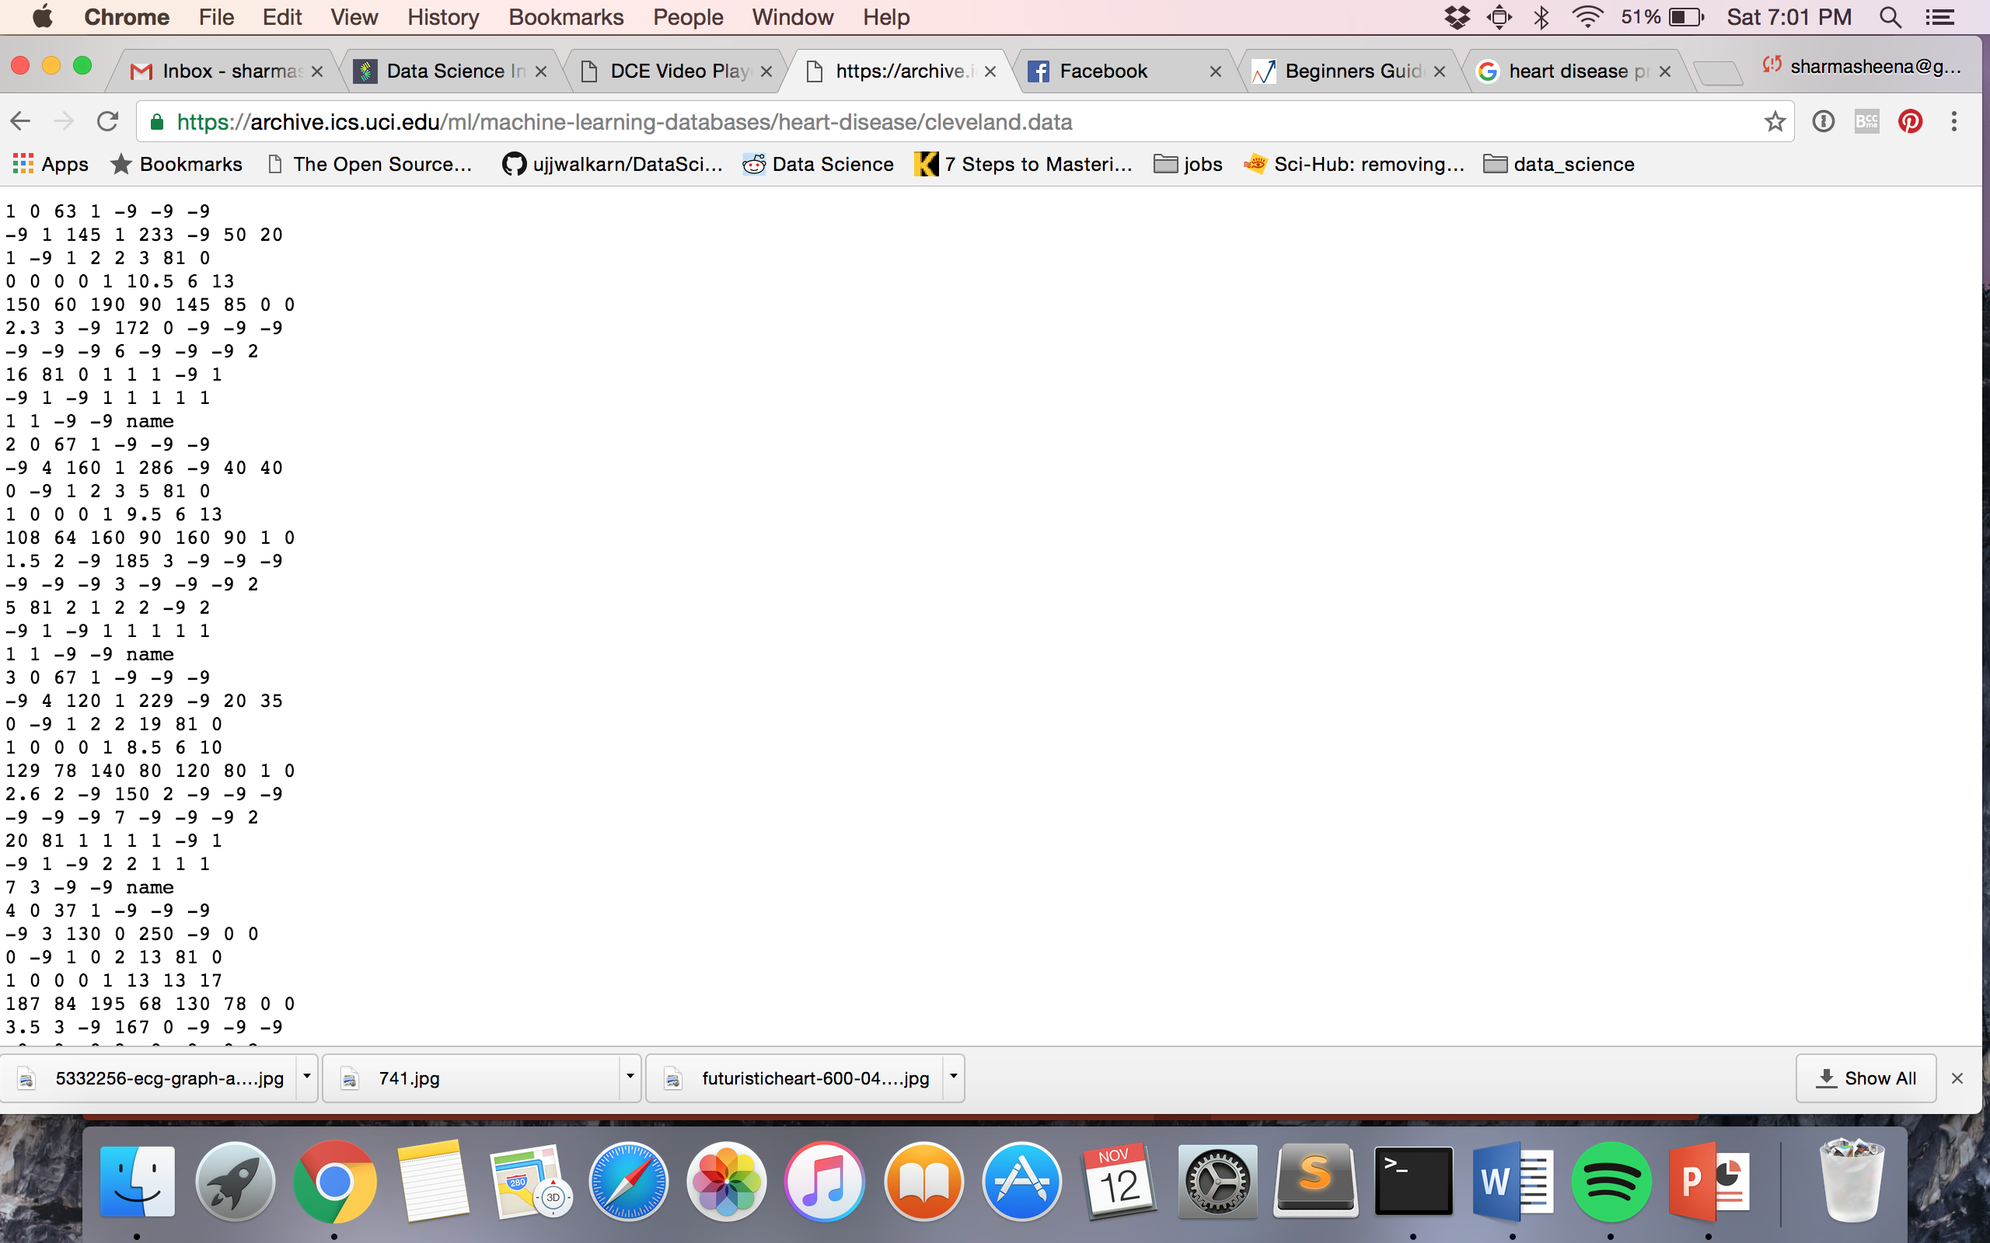
DATA
Data source: UCI repository:
https://archive.ics.uci.edu/ml/datasets/Heart+Disease
3 tables used and joined (data from Cleveland, Hungary, and Switzerland)
Each table has 76 attributes
Raw data example to the right
Data from each participant ends with ‘name’
Notes:
Data was acquired from the UCI repository. There were 3 unique tables from 3 regions (Cleveland, Hungary, and Switzerland). Each dataset had the same 76 attributes – such as sex, age, rest heart rate, maximum heart rate, history of heart disease, and history of diabetes. After combining all 3 data sets there were a total of 617 unique sets of patient data.

Slide 4
DATA
Data was cleaned:
Features with greater than 50% missing values were eliminated
Features with personal information were eliminated (name, social security number, ID#)
Feature columns that were left entirely blank were eliminated
Feature columns in which the label was unclear were eliminated (a column of numbers with no discernable heading or interpretation)
Remaining features:
Sex – Male or Female | Ex_bp1 – peak systolic exercise blood pressure
Age – Patient Age | Ex_bp2 - peak diastolic exercise blood pressure
Rest_bp – Resting blood pressure (mmHg) | Cp_type – chest pain type
Chol – serum cholesterol (mg/dl) | Fbs – fasting blood sugar < 120 mg/dl (1 =True, 0 =False)
Max_hr – Maximum heart rate | Rest_ecg - resting electrocardiographic results
Rest_hr – Resting heart rate | Exang - exercise induced angina (1=True; 0 =False)
Slope – slope of peak exercise (1=up, 2=flat, 3=down) | Oldpeak - ST depression induced by exercise

Slide 5

CLASSIFIER
Random forest model – a model similar to the game 20 questions
I’m thinking of a …. Shoe.
Is it something you wear?
NO
YES
Is it something outside?
Is it something you wear on your feet?
NO
YES
Is it something you wear on your hands?
Is it a shoe??
Train the model using training data and test the model on a hold-out data set
Notes:
A random forest model was used. To understand this model, lets think of the game 20 questions. If you are thinking of an object – lets say a shoe – I will begin to ask questions to try to come to the answer ‘shoe.’ I’ll ask ‘Is it something you wear?’ If NO then I change my line of questioning and say ‘Is it something outside?’ but if YES then I hone in by asking ‘is it an outer layer of clothing?’ and so forth. Eventually by going through a set of questions we can create a decision tree and end up with the answer shoe. Essentially we combine a bunch of decision trees together to form a random forest.
First we need to train the model on a set of the data (training set) and then test the model on new data that the model has never seen before.

Slide 6
STRENGTH OF MODEL
This is a measure of well the model performs on both the training data and the hold-out data.
The model performed well for Class 0 (no heart disease).
Notes:
This graph is showing us how well our model did on the training set and the hold-out set. A score of 1 means the model performed perfectly and chose the correct class label for every instance. Here we can see that the model performed pretty well for both the training and test sets for CLASS 0 only. In the 4 heart disease classes , the model doesn’t perform too well on the test data – which is what we’re concerned with (scores from 0.15 - 0.4)

Slide 7
STRENGTH OF MODEL
CONFUSION MATRIX – shows us how labels our model gets correct and how many it doesn’t, for
Notes:
If you look along the diagnol starting from the upper left, we can see how many times the model correctly predicted the class label for all 5 classes. So for Class 0 , 34 were predicted correctly, 4 were predicted to be class 1 but were really class 0, 1 was predicted to be class 2 but was really class 0, and so on.
Again we can see this is performing well for class 0 .

Slide 8
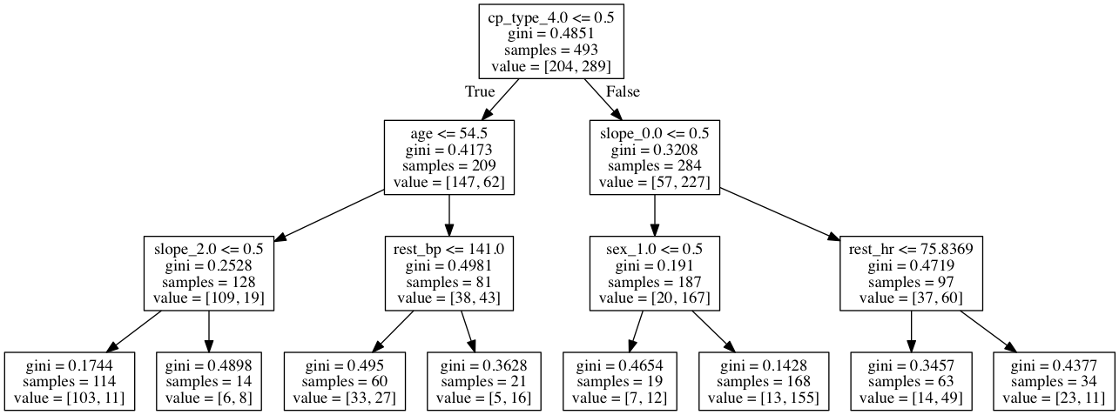
TAKE HOMES
Can really only predict no HD vs HD with any confidence. Relevant features for predicting HD:
Decision tree :
Notes:
This decision tree has allowed me to come to the following recommendations: Those with asymptomatic chest pain, below the age of 54.5, who do not have a flat slope of the peak exercise ST segment are NOT likely to develop heart disease (103 in class 0 and 11 in class 1). Those with asymptomatic chest pain, who do not have an upsloping slope of the peak exercise ST segment, and are female are likely to develop heart disease (13 in class 0 and 155 in class 1).
with a maximum heart rate of less than or equal to 96.5 will likely develop heart disease

Slide 9
IMPROVING THE MODEL
More data
More features
Combining methods

